Slide 1
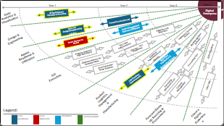
3 Year Roadmap
2025
2026
2027
Engineering Design P1
Digitize Lab Tests and SPR
Auto Sample Login & WSC
Complexity Matrix
Lot Numbers
Auto Ticket Numbers
AP Automation
B2B
Digital Client Signatures
Engineering Design P2
OVPP Driver Data Entry
Dynamic Pricing Tool Automation
D365 Upgrade
Notes:
Delays
Vacations
The Company section was far more complex then estimated
BPAVS support
eService Support

Slide 2
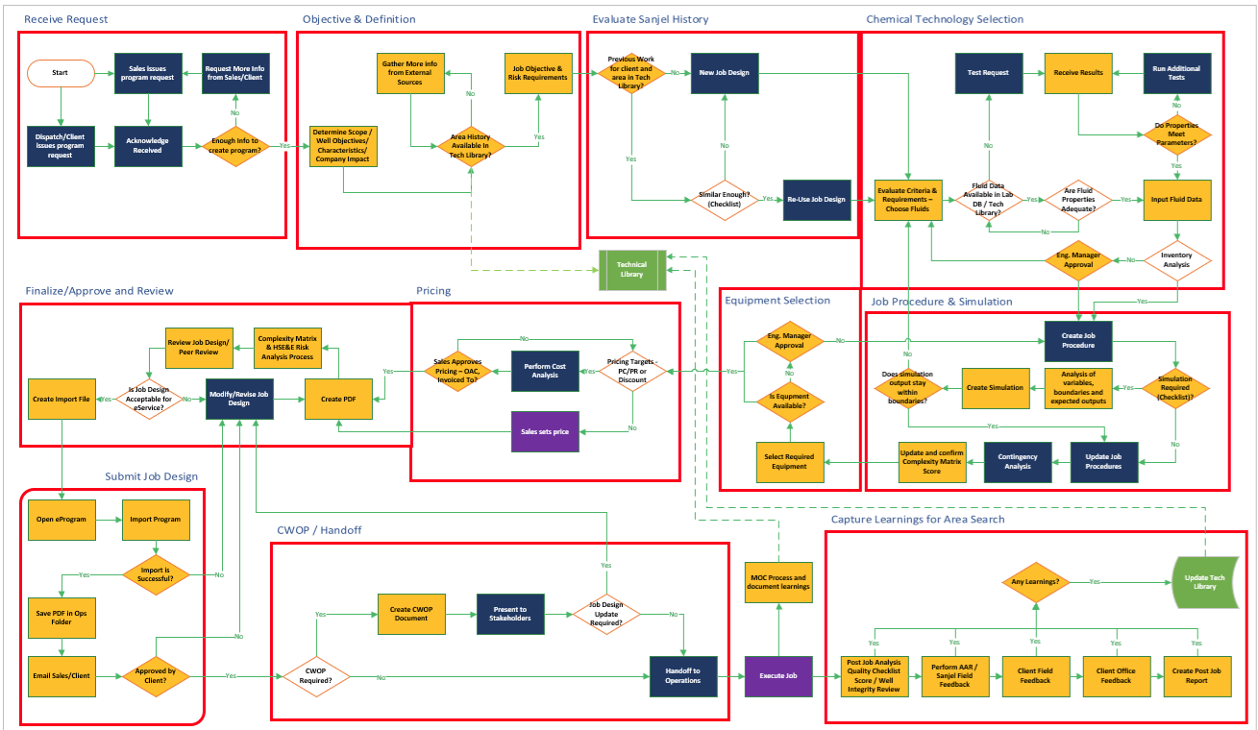

Slide 3
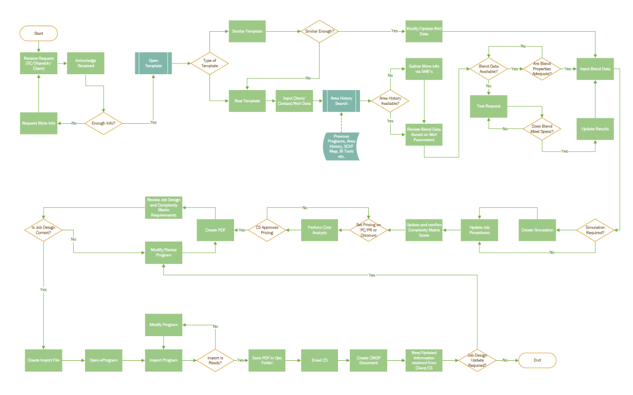

Slide 4
Job Design Tool – Major Parts
Program workflow management
Input Tool
Program Output
Costing
Integration with Engineering Data Sources:
Lab database
Returns and Excess
SCVF
Product Inventory
Frac gradient
Export to Other Digital Processes
Well Diagram Builder
Complexity Matrix – Risk Score Calculator
Risk Mitigation Step Selector (CWOP, field blend testing)
Lab Test Request Tool
Import from other Digital Processes
Notes:
Discussion of Requirements:
Needs to have ease of copying/pasting old programs to new ones seamlessly
Simulation and testing attached for easy reference
Cementics model of having everything integrated is appealing
Group was very open to the idea of using the simulator (CEMPRO or Cementics) as the input tool (inputting everything once)
Program output, some discussion of whether that would produce a Word, Excel or other type of document
Import tool for old programs, stick diagrams, well surveys, logs
Reduce the slowness, clunkiness
Frac gradient database
Design guidance from Engineering Basis of Design, like CEMPRO red/yellow/green scheme for design elements

Slide 5
Job Design Tool – Phase I
Program workflow management
Input Tool
Program Output
Costing
Well Diagram Builder
Lab Test Request Tool

Slide 6
Job Design Tool – Phase I Value
Value
  Engineering work management – traceability for APEGA & EGBC
    Visibility of who/when/type
  Engineers focused on engineering, not data entry
  Job design enhancement
    Increased integration
  Job design consistency
  Simplified costing
    More visibility of trends and competitor benchmarks
    Efficient PC/PR targeting – trends over time instead of snapshot
  Faster and improved communication
    Know stage of job design process
Value
  Complexity Matrix Workflow prerequisite
  Ease of use allowing the right person to do the right job
  More defined/enhanced job & material forecasting
    Addition of job by job info
  eProgram/Rig Board/Job Board/eService integration
    Additional details
  More accurate revenue forecasting
    Program by program details
  Client value:
    Faster program turnaround
    Improved easier to read layout
    Risk mitigation – less errors
Ownership – define the decision makers
  Workflow Management:
    Jeremy
  Input tool:
    Jeremy
  Design output
    Content: Jeremy
    Look & Feel: Kevin and Brett H. and Lauren as consultant
  Well Diagram:
    Jeremy
  Lab Test Request:
    Jeremy & Ryan
  Costing:
    Kevin

Slide 7
Job Design Tool – Phase I
Program Workflow Management
View Programs, filter by Service Point, Client, Rig, Sales Project, Date, Job Type, Designer, Sales Rep, etc. - 10
Create Program Request - 15
Approve Program - 20
Prioritize Program Request - 5
Review Program - 5
Linkage to Sales Project - 5
Linkage to job design tool. (Currently Excel JDT) - 20
Notes:
Important for Sales to be able to easily submit new program requests remotely, providing minimal amount of data

Slide 8
Job Design Tool – Phase I
Feed data in Cempro / Cementics for simulation - 40
Export data from Cempro for job design improvement -20
Well Diagram generation – 10
Need to explore Cementics – where does this fit?
Simulation

Slide 9
Job Design Tool – Phase I
Import from stick diagram (Research needed) -30
  Urgency is nice to have
  Can work with a timeframe
Mange engineering information
  Well Information / Open Hole / Casing pipe / Formation -10
  Casing requirements -10
  Drilling Fluid -5
  Contact info -5
Input Tool
Notes:
How do we deal with differences or changes required?
The simulation and the input file may be different – Do I care?

Slide 10
Job Design Tool – Phase I
Sales Forecast/OPS Forecast consolidation - 20
Lab Database integration
  Test Request creation - 10
  Blend Selection - 20
Volume Calculation - 20
Excess suggestion - 10
Blend selection – 10
Design Tool / Lab / Integration
Notes:
How do we deal with differences or changes required?
The simulation and the input file may be different – Do I care?

Slide 11
Job Design Tool – Phase I
Client facing document
  Create per job type:
    Well Profile
    Product summary
    Blend(s) & Additive(s)
    Equipment list
    Expected pressure
      Calc or sim?
    Procedures
    Key Instructions & highlights?
    Quality page?
Ability to create procedures that can be sent to a client (without pricing)
Ways to save specific procedures….
  Client specific
  Area specific
  Special job types
  Ability to select the desired procedure
How to create multiple options without writing an entire new program
Program Output

Slide 12
Job Design Tool – Phase I
Program Workflow Management
Easy way for sales to get data into the system
Tool to manage:
  Request(s)
    Prioritize
    Assign
  Acknowledgement
  Completion
  Review – peer & senior
  Approval - mgt
Incorporate Complexity Matrix Details
Linkage to Sales Forecast
  Maintain latest revision in SF and OpsF
Add details to SF
  Addition of programs to a project
  Program per well
  Defining pad(s) per project
Ops Forecast
  Multiwell programs
  Individual programs
    Pad work
  Link proper job to program in ops forecast – 1 to 1
Notes:
Important for Sales to be able to easily submit new program requests remotely, providing minimal amount of data

Slide 13
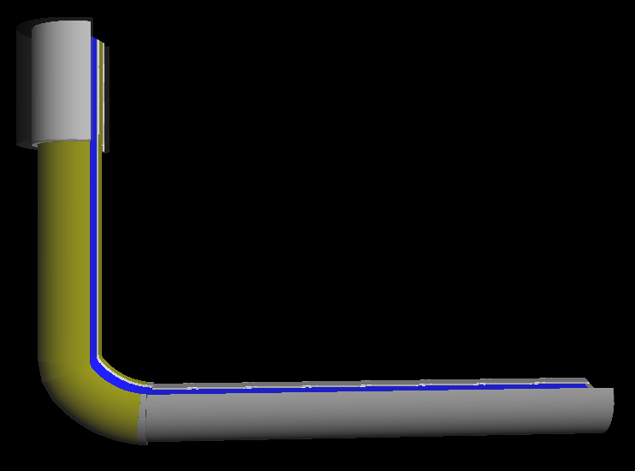
Job Design Tool – Phase I
Update fluid database
  This is CEMPRO
  Update and share file
Temperatures
  Which temps to use?
    Calc vs sim
Pressure
  Bring in pump pressure chart?
What other info do we want to bring in?
Save as CP1 file
Can open with notepad
Capture well diagram
  Which one?
Simulation

Slide 14
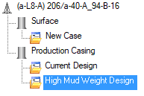
Job Design Tool – Phase I
Start with simulation
  Import sim file
Validate
  Products & Additives
  Performance criteria
Ability to reuse any part
  Well profile
  Client & well profile
  Blends?
    Add in sim or input tool?
  Additives?
    Add in sim or input tool?
Volume/Blends/Additives from where?
  Depths or changes are required – where does this happen?
  Is recalculation required?
  Modifications where?
  Integration to lab db
When opening sim, how to choose an option?
Input Tool
Notes:
How do we deal with differences or changes required?
The simulation and the input file may be different – Do I care?

Slide 15
Job Design Tool – Phase I
Client facing document
  Create per job type:
    Well Profile
    Product summary
    Blend(s) & Additive(s)
    Equipment list
    Expected pressure
      Calc or sim?
    Procedures
    Key Instructions & highlights?
    Quality page?
Ability to create procedures that can be sent to a client (without pricing)
Ways to save specific procedures….
  Client specific
  Area specific
  Special job types
  Ability to select the desired procedure
How to create multiple options without writing an entire new program
Program Output

Slide 16
Job Design Tool – Phase I
Job Design Price Page
Ability to modify pricing
  Product quantities?
  Create client specific requirements?
    E.g. Add WITS?
  Area specific requirements?
    E.g. Add chains?
Ability to conduct costing / inventory per product
Ability to show recent pricing by client, by area
Ability to create price with target PC/PR for products
  Enter target PC/PR
  Calculate product price
Attached pricing to program
Once complete, compile client facing document for email
Attach document to eProgram
Attached document to eService Call Sheet / Job package
Ability to price and create client facing documents without simulation
  What is the starting point?
  Are there 2?
    Can they integrate?
Will the supply chain tool provide forward looking prices/costs to Sanjel?
Pricing / Costing

Slide 17
Job Design Tool – Phase I
Well Diagram from CEMPRO
Ability to move image to job design
  Or create new diagram from CEMPRO data
How to recreate if things change?
  Save planned vs actual?
  Show differences?
Ability to save the image to the file
  Reuse on another design?
Well Diagram Builder

Slide 18
Job Design Tool – Phase I
Ability to create lab request
  Current request form covers all proper information
  Need pilot test capabilities (on demand test request)
  Need ability to add test request for field blend testing
Use current function
  Ability to do on demand
    Pilot testing
  Ability to automate field blend testing
    Field blend testing
  Don’t want to import multiple test requests
    Do once to cover multiple requirements
  Add temperature and pressure ramps? Move from simulation to lab request?
  Dealing with Hesitation…. How to do this when outside of the simulation?
Lab Test Request Tool

Slide 19
Job Design Tool – Linkages?
Input Tool
Process data – integration & calculation
Program Output
Integration with Engineering Data Sources:
Lab database
Returns and Excess
SCVF
Product Inventory
Frac gradient
Use XS data from calculated values
Calculated per job
AER data
  Well name
  Location
  Target formation
  Substance
Inventory part of engineering
How to simulate while needing info from the integration points?
Starting point?

Slide 20



Sales Forecast
Ops Forecast
Program Management
Simulation
Job Design
eProgram

Slide 21




Job Design Tool – Linkages?
Sales Forecast
Ops Forecast
Sales Forecast
Ops Forecast
Program Management / eProgram
Sales Forecast
Ops Forecast
Program Management / eProgram
Program Management / eProgram

Slide 22
Job Design Tool – Linkages?
At program, add sales project # to create linkage
  Ability to map multiple programs to 1 SP
  How to know order of programs?
    Sort in Program Management?
If no sales project #, imported program can create sales project – what are the consequences??
Will walk Jeremy through the SF – OpsF process
Sales Forecast
Ops Forecast
Program Management / eProgram

